Slide 1
Year 10 PREATAR Science
Introduction to DNA

Slide 2
Review - Organelles
Quiz: Cell Organelles and Their Functions (biologycorner.com)

Slide 3
Learning Intentions
The transmission of heritable characteristics from one generation to the next involves DNA and genes
describing the role of DNA as the blueprint for controlling the characteristics of organisms
using models and diagrams to represent the relationship between DNA, genes and chromosomes

Slide 4
Success criteria
Draw or label a diagram showing the components of DNA (phosphate, deoxyribose sugar, base)
Explain complimentary base pairs and write complimentary code
State one interesting fact about DNA

Slide 5
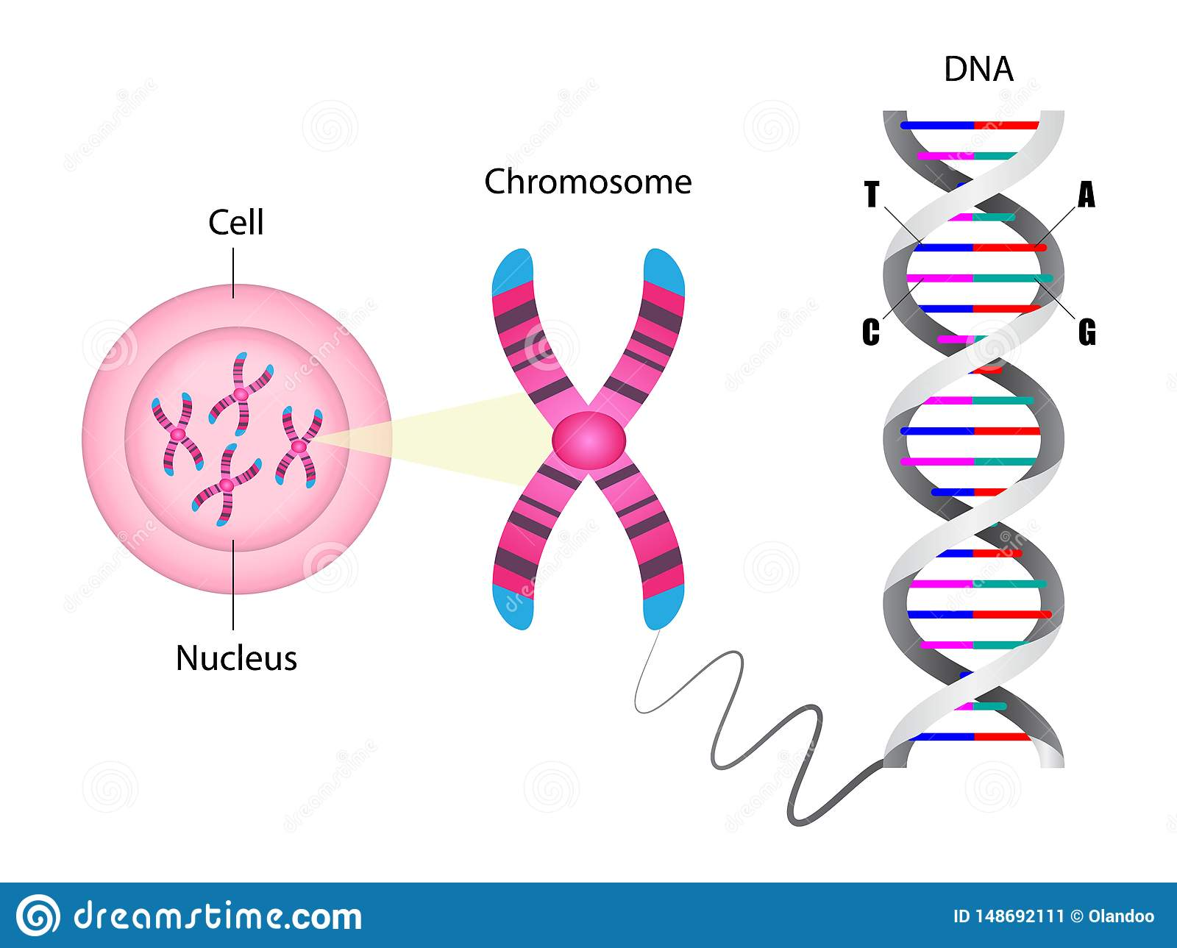

Slide 6
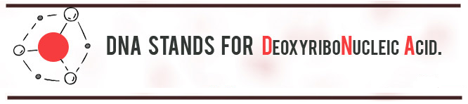

Slide 7
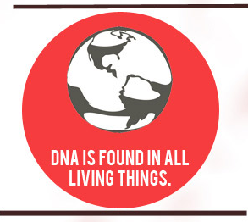
DNA is found in every cell in your body except red blood cells.
Only 10% of the DNA in your body is yours!

Slide 8
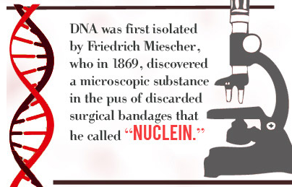

Slide 9
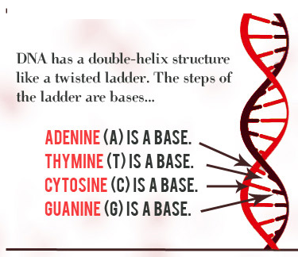

Slide 10
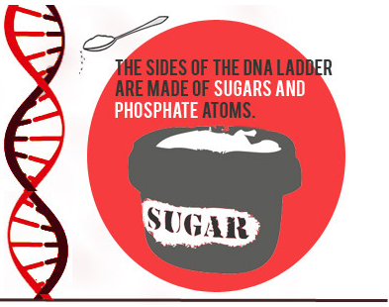

Slide 11
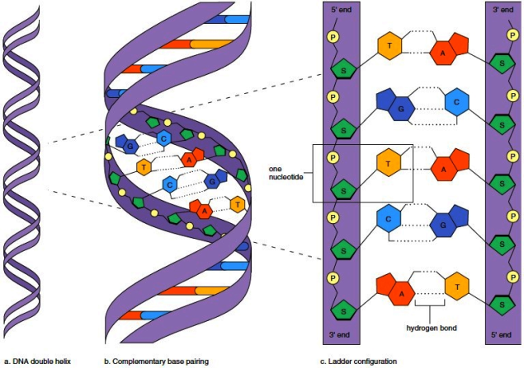
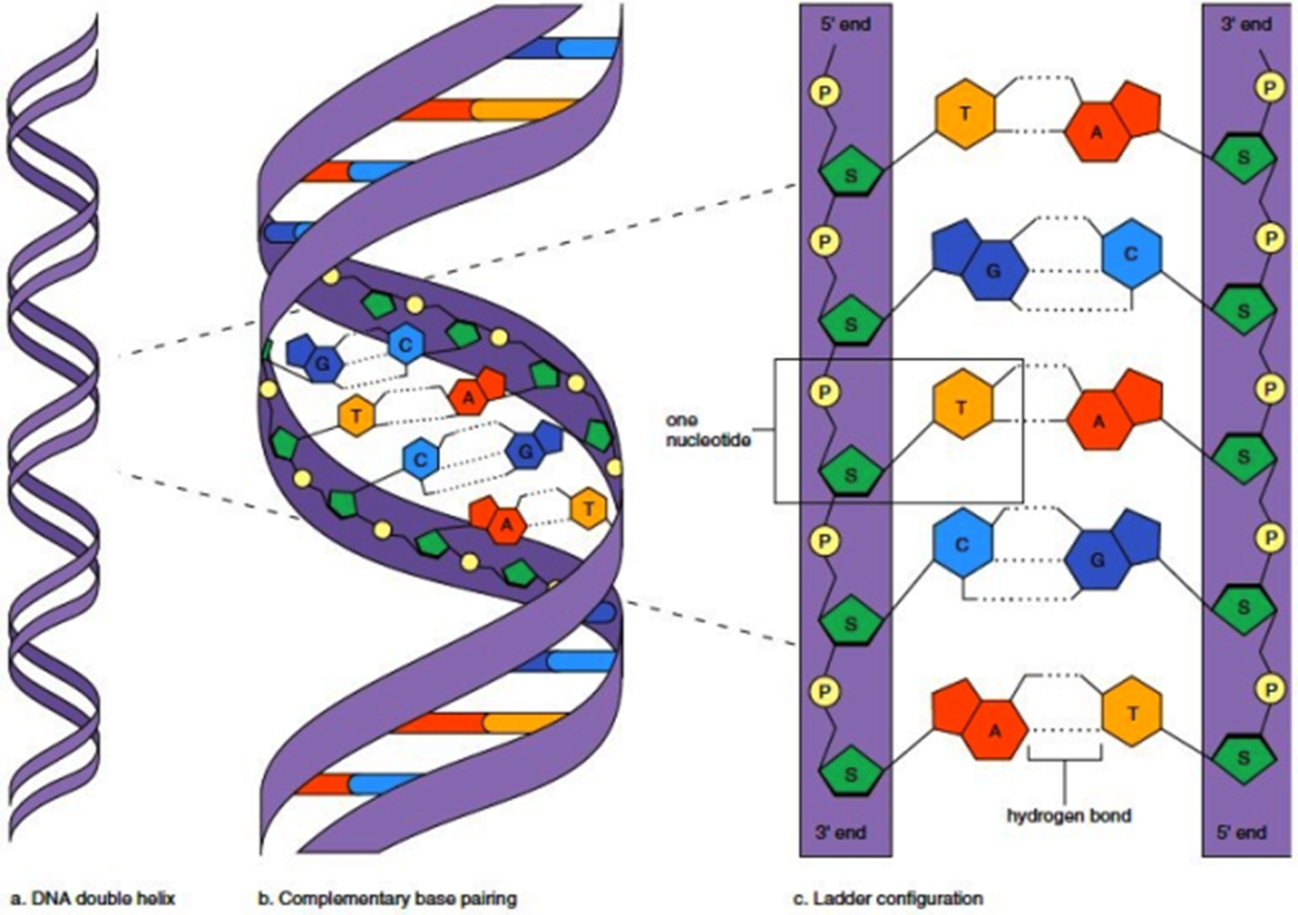

Slide 12
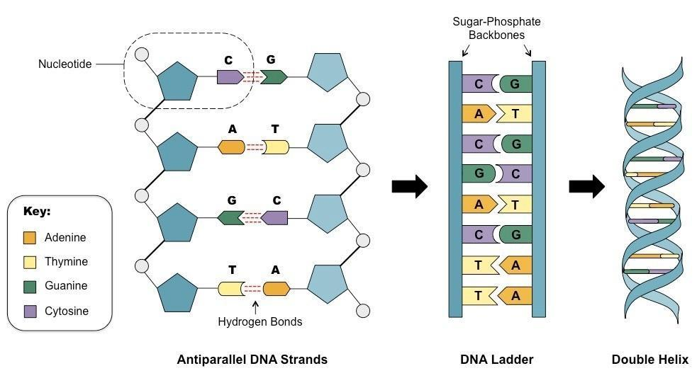

Slide 13
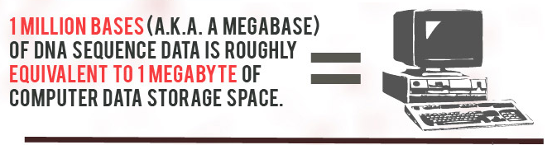

Slide 14
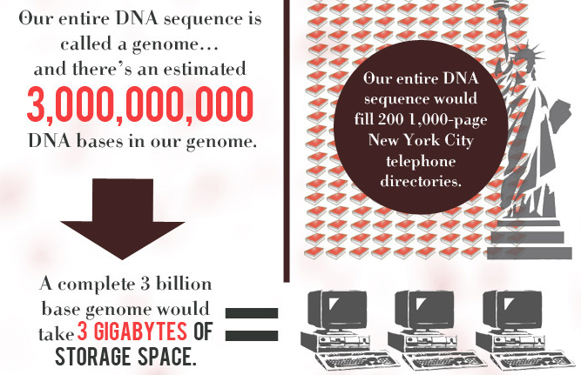

Slide 15
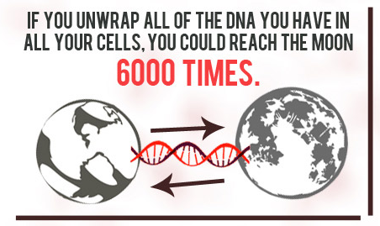
Each of your cells contains around 6m of DNA
But DNA is so fine you could fit 25 000 strands of it side by side in the width of a human hair

Slide 16
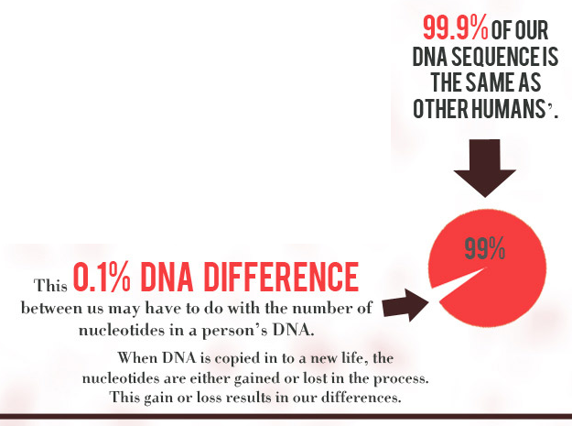
About 8 % of the human DNA is made up of ancient viruses that used to infect us

Slide 17
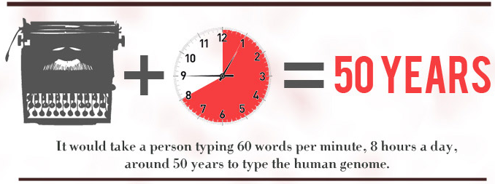

Slide 18
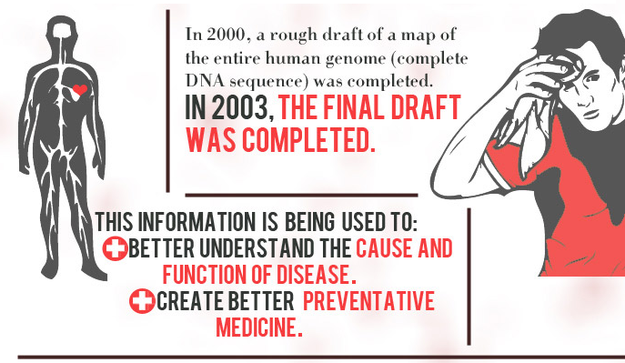

Slide 19
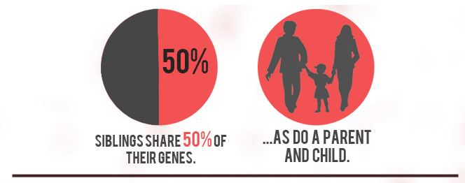
Theoretically, an egg’s genetic contents can be replaced with male DNA and then fertilized by sperm. Two males could be the biological parents of a child.

Slide 20
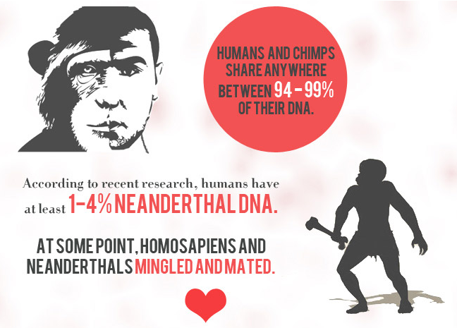
Humans and bananas share about 50% common DNA.

Slide 21
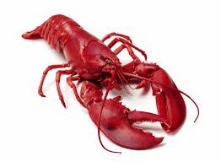
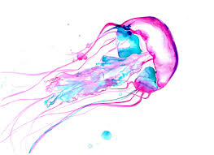
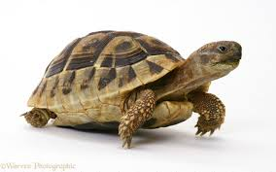
With each cellular replication, DNA becomes a little weaker or less efficient. But there are some species whose DNA does not appear to break down over time Lobsters, some fish, and many tortoise species do not appear to age, and under completely optimal circumstances, could essentially live forever.

Slide 22
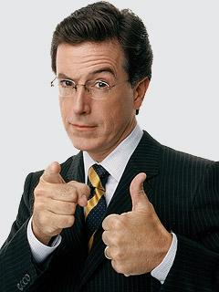
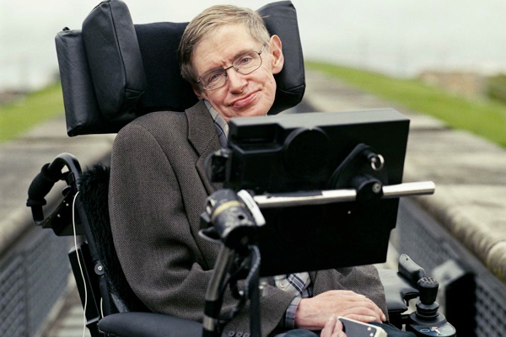

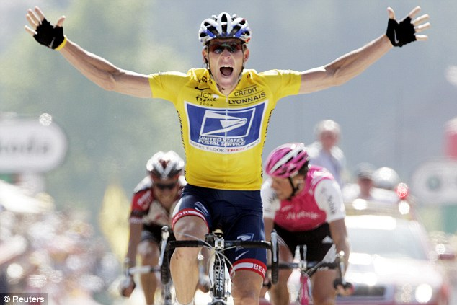
On October 12, 2008, a Russian Soyuz spacecraft flew a mission to the International Space Station orbiting around earth. On board, it carried a small memory device with the digitized DNA sequences of various (questionably) important people, including comedian Stephen Colbert, physicist Stephen Hawking, “Playboy” centerfold Jo Garcia, and shamed pro cyclist Lance Armstrong. The purpose of the drive is to provide the building blocks to resurrect humanity should an apocalyptic event destroy the planet.

Slide 23
Success criteria
Draw or label a diagram showing the components of DNA (phosphate, deoxyribose sugar, base)
Explain complimentary base pairs and write complimentary code
State one interesting fact about DNA

